Slide 1


MOVIE TICKET BOOKING SYSTEM
SUPERVISOR Mr.A.Malarmannan,M.E., AP/CSE.
PRESENTED BY
2303811710422142 – SHAMIRTHA J

Slide 2

PRESENTATION OVERVIEW
Objective
Project Introduction
Problem Statement
Methodologies (Programming concepts relevant to problem statement)
Architecture of the proposed system
List of Modules
7. Merits
8. Results and Discussion
9. Queries

Slide 3
OBJECTIVE
The objective of the Movie Ticket Booking System is to provide an easy-to-use application that allows users to select a movie, choose a time slot, pick seats, and calculate the total ticket cost.
The system simulates a real-world booking process with features like seat selection, total cost calculation, booking confirmation, and the ability to reset selections or exit the application.
It aims to deliver a simple and interactive experience for users while ensuring accurate cost calculations and smooth operation.

Slide 4
PROJECT INTRODUCTION
The Movie Ticket Booking System is a software application that simplifies the process of booking movie tickets through a user-friendly graphical interface.
Built using Java's AWT, the system allows users to select a movie, choose a time slot, pick seats from a grid, and calculate the total cost based on the number of tickets.
It also provides features like booking confirmation, resetting selections, and exiting the application. The project aims to offer a practical, interactive experience for users to easily book tickets for their desired movie.

Slide 5
PROBLEM STATEMENT
Inefficiency in Manual Booking: Traditional movie ticket booking (in-person or over the phone) is time-consuming and prone to errors.
Complexity in Seat Selection: Managing seat availability and making selections manually can be confusing and inconvenient.
Difficulties in Calculating Total Cost: Without an automated system, calculating the total cost based on movie selection and ticket count can be error-prone.

Slide 6
Methodologies (Programming concepts relevant to problem statement)
Object-Oriented Programming (OOP)
Encapsulation: The functionality related to booking tickets, seat management, and calculations is organized in classes..
Abstraction: Complex internal processes are hidden from the user, focusing only on the user interface for ease of interaction.
Graphical User Interface (GUI) Design
AWT is used to create a user-friendly interface with components like labels, buttons, and drop-down menus for movie selection, time, and seat booking.
Event-Driven Programming
The system responds to user actions like button clicks using event listeners to trigger specific actions such as calculating totals or booking tickets.

Slide 7
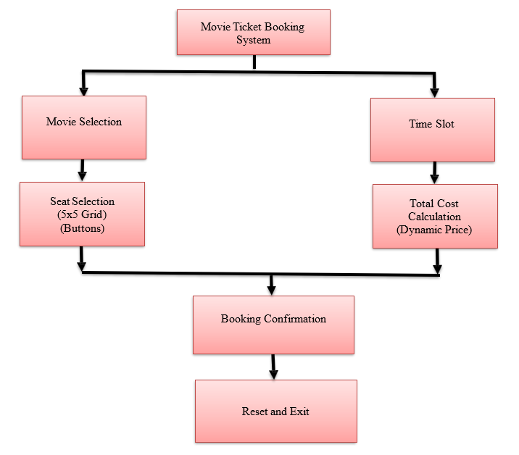
FLOW DIAGRAM

Slide 8
MODULE DESCRIPTION
User Interface (UI) Module
Creates and displays the graphical interface using AWT, allowing users to interact with the system.
Movie and Time Slot Selection Module
Allows users to select a movie and time slot from dropdown lists, recording their choices.
Seat Selection Module
Displays a grid of available seats and updates their status when selected or deselected.
Total Cost Calculation Module
Calculates and displays the total ticket cost based on selected seats and movie price.
Booking Confirmation Module
Shows a confirmation message with booking details after seat selection and cost calculation.
Reset and Exit Module
Resets all selections or exits the application when the user clicks the respective button.

Slide 9
MERITS
Easy to Use: User-friendly graphical interface.
Real-Time Seat Selection: View and select available seats instantly.
Automatic Calculation: Total cost is calculated automatically.
Error-Free: Handles invalid inputs smoothly.
Efficient Booking: Streamlines the booking process.

Slide 10
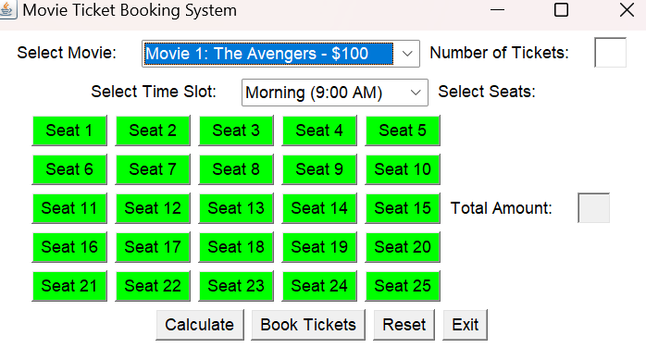
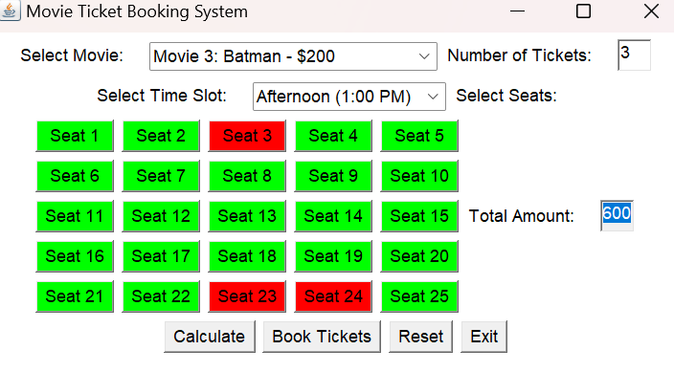
RESULT AND DISCUSSION

Slide 11
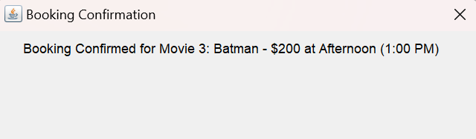
RESULT AND DISCUSSION

Slide 12
ANY QUERIES ?

Slide 13
THANK YOU

